Slide 1
Capstone Project: Analysis of Stock price and forecasting using LSTM
Rezoan Ahmed Shuvro

Slide 2
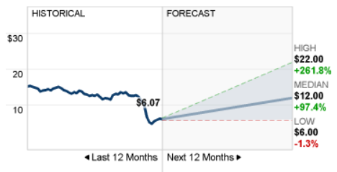
Objective
Filter stocks from the S&P 500 based on users coice
To perform exploratory data analysis to observe various stock price trend and analyze the stock price behavior of different stocks.
To develop a simple LSTM based model for predicting the upward/downward trend for a stock using historical stock price data and predict future stock price.
Use the prediction price from the model to decide which stocks to buy
Energy transfer stock prediction (source: CNN)

Slide 3
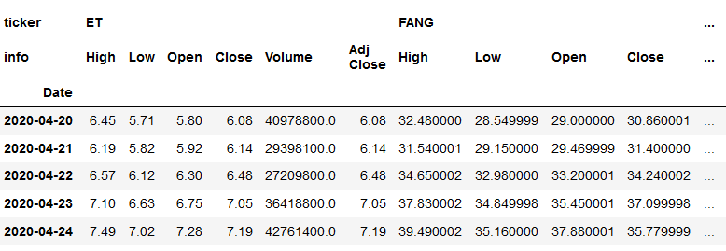
Data collection
Used pandas datareader API to scrap stock prices data from ‘yahoo’
Data was then manipulated to create the following DataFrame where:
rows represents time series of date
Columns represent a hierarchical table of stock tickers and prices info

Slide 4
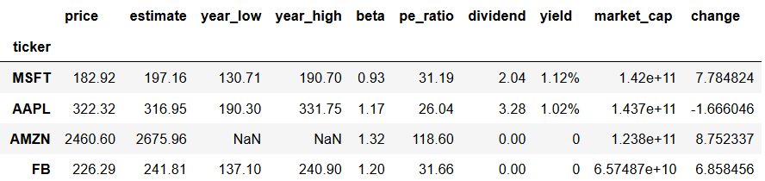
Data cleaning
First scrap data from yahoo finance
Populate the following table
Issues:
Market cap includes B for billion, M for million, T from trillion. Convert them to integer
Define change using pct_change using price and the wall street estimate
Convert objects to float
Populate dividend values and replace Nan with zero

Slide 5
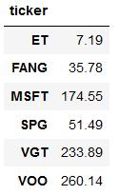
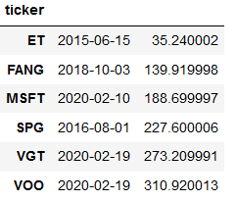
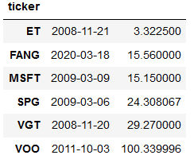
Data analysis
pd.merge(pd.DataFrame(my_stocks.xs(key='Close',axis=1,level='info').idxmax()), pd.DataFrame(my_stocks.xs(key='Close',axis=1,level='info').max()),on='ticker')
pd.merge(pd.DataFrame(my_stocks.xs(key='Close',axis=1,level='info').idxmin()), pd.DataFrame(my_stocks.xs(key='Close',axis=1,level='info').min()),on='ticker')
Last day’s price
All time high
All time low
SPG, FANG, ET are close to their all time low
MSFT,VOO, VGT are very close to their all time high

Slide 6
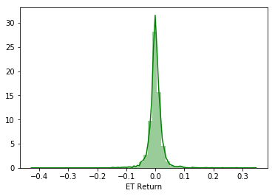
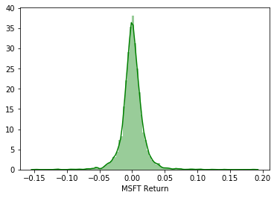
Data analysis
- Distribution plot of the standard deviation of the return (calculated using the percentage change) indicates that ET stock is more fluctuations in prices compared to MSFT

Slide 7
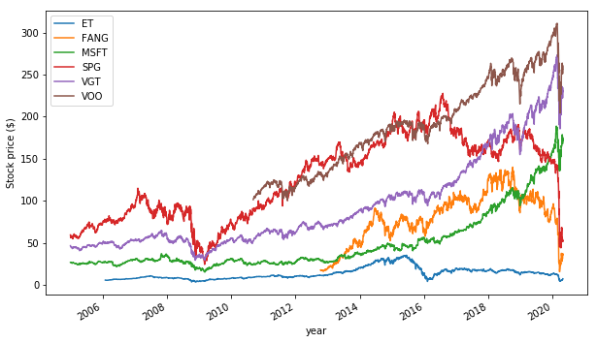
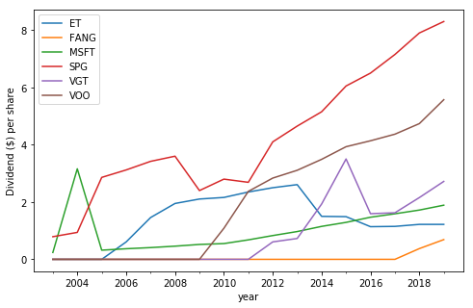
Stock price and dividend over time
Stock price
Dividend
- SPG, MSFT, VOO are very stable dividend payers. While ET pays dividend at a decent ratio, but the dividend is not growing

Slide 8
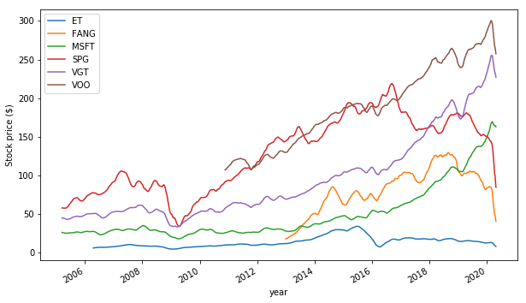
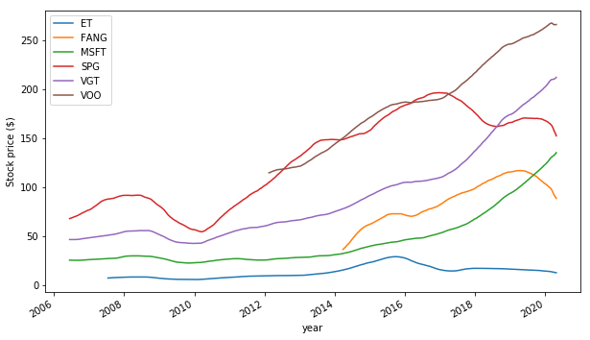
Smoothing the variance of the stock prices
50 day rolling average
365 day rolling average
Time series of the 50 day and 365 day rolling average gives a high-level idea about the stock type.
For example, MSFT is a still growing (growth stock)
Energy transfer pays dividends to the share holders. It’s a dividend stock

Slide 9
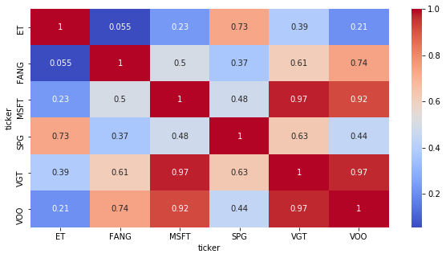
Correlation between stock price
- Correlation between stocks can be used to identify similar stocks. For example VGT (technology index and VOO (S&P 500 index are heavily correlated))
- To enhance diversity of the portfolio, avoid investing all of your investments in the same bucket

Slide 10
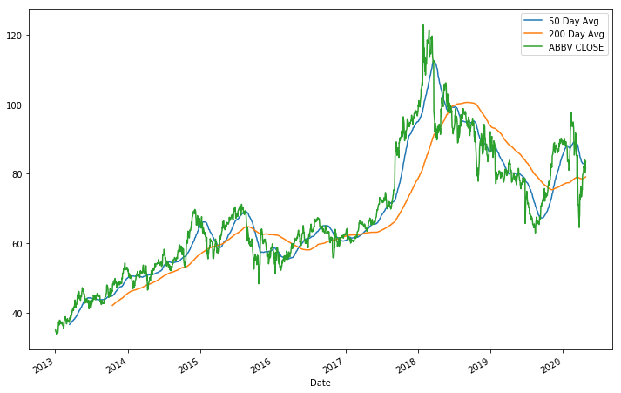
50 Day moving avg vs 200 day moving Avg.
bearish
bullish
- When 50day moving average cuts the 200day moving average, it is called the golden cross
- 50day moving average cuts the 200day moving average and the slop is positive, it’s a bullish signal (buy)
- 50day moving average cuts the 200day moving average and the slop is positive, it’s a bearish signal (sell)
The figure above for the ticker ‘ABBV’ (a pharmaceutical stock) validates the above-mentioned fact

Slide 11
Filtering
Used filtering based on users choice to filter stocks to buy.
For example, see the following filtering: here user wants tofilter stocks that have market cap over 10B, beta values less than 1 (less risky stocks), pct change greater than 10 (greater reward), pays dividend greater than 3%, and pe ratio less than 30 ( not overpriced)
filter = stocks_filter[(stocks_filter.market_cap> 10000000000) & (stocks_filter.beta < 1) & (stocks_filter.change >10) & (stocks_filter.pe_ratio <30) & (stocks_filter.dividend >3)]
The filtering criterion resulted with the following 4 tickers JNJ, AMGN, PM, UNH
Notice that 3 out of 4 stocks are pharmaceutical, wall street expects higher return from pharma stocks in future as response to covid 19

Slide 12
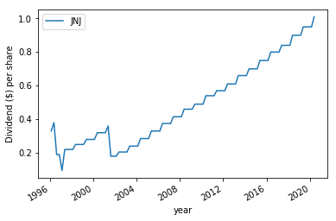
Dividend (example JNJ)

Slide 13
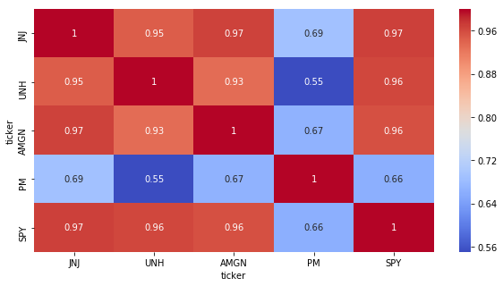
Correlation between stock price
- Correlation between stocks can be used to identify similar stocks. For example SPY (S&P500 index P 500 index are heavily correlated)) and pharma stocks are heavily correlated

Slide 14
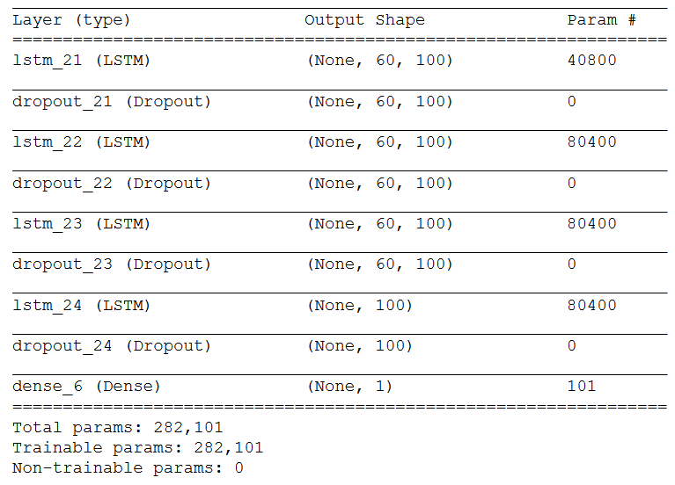
Summary of the LSTM model and parameters

Slide 15
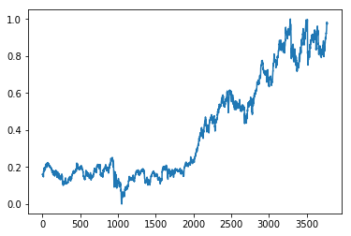
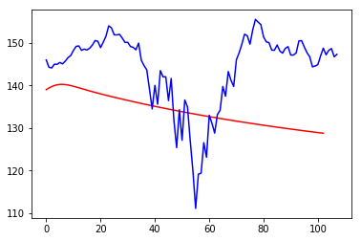
JNJ
Time series data from 2005 to 2019 (training data )
Time series data from for the 5 months of 2020(test data). Red line shows the predicted stock prices using LSTM model

Slide 16
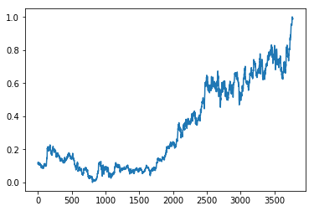
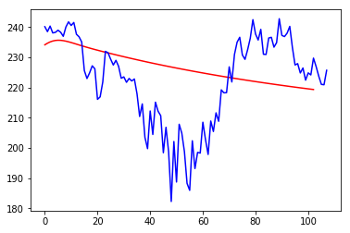
AMGN
Time series data from 2005 to 2019 (training data )
Time series data from for the 5 months of 2020(test data). Red line shows the predicted stock prices using LSTM model

Slide 17
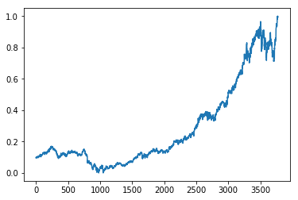
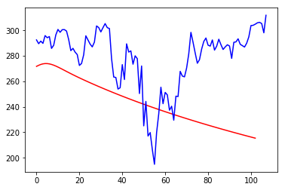
UNH
Time series data from 2005 to 2019 (training data )
Time series data from for the 5 months of 2020(test data). Red line shows the predicted stock prices using LSTM model

Slide 18
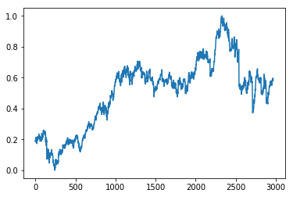
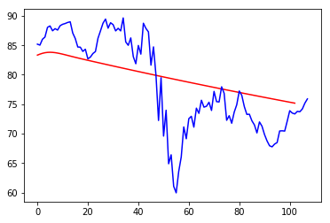
PM
Time series data from 2005 to 2019 (training data )
Time series data from for the 5 months of 2020(test data). Red line shows the predicted stock prices using LSTM model

Slide 19
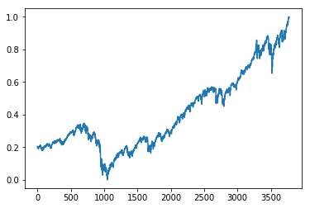
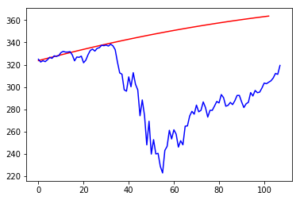
SPY
Time series data from 2005 to 2019 (training data )
Time series data from for the 5 months of 2020(test data). Red line shows the predicted stock prices using LSTM model

Slide 20
Table 1: prediction analysis
For simplicity I assumed, equal investments on the filtered stocks
Ticker | price on Dec 31 | Model (5 months predicted) | prediction MSE | actual | model return | model return (individual ) | actual return (individual ) | Actual return
JNJ | 145.87 | 128.78 | 13.43 | 146.99 | -14.8% | -11.7% | 0.77% | -2.701%
AMGN | 241.07 | 219.30663 | 16.01 | 222.74 |  | -9.0% | -7.60%
PM | 85.09 | 75.18 | 6.08 | 77.1 |  | -11.6% | -9.39%
UNH | 293.98 | 215.39 | 44 | 310.75 |  | -26.7% | 5.70%
SPY | 321.86 | 363.61 | 62.72 | 320.68 | 13.0% | 13.0% | -0.37% | -0.37%

Slide 21
Analysis
Model return | -14.8%
Actual return ( filtered stocks) | -2.7%
model SPY return | 13.0%
Actual SPY return | -0.4%
Model return suggests significant loss compared to SPY. So suggestion is to buy SPY (SP 500 index)
From the actual data, we can see that although both returns are negative, SPY loss is less compared to the filtered stock.

Slide 22
Future works
Add more features in prediction, seasonality, holiday sales, quarterly information and so on.
Recently I came to know about facebook prophet library for time series which integrates new features easily. It would be nice to play with that.
Running neural networks on my computer is a pain. It takes ages to run 5-10 epochs. Further hyperparameter tuning, grid search, more epochs would increase the RMSE of the model.
Do the linear optimization to find the value to weight parameters.

